Slide 1
What are my Options after High School?
College
Military
Technical College
Special Purpose School

Slide 2
Traditional Options after High School
Work
Technical College
Military
Apprentice Program
Proprietary schools
College (2 years, 4 years and beyond)
Notes:
Career planning and decision making requires high school students to select classes based on the information they have gathered regarding future careers/occupations. Depended upon the career choice a student has various options upon which they can choose. Some careers demand a 2-years associate’s degree to be competitive in the field or some careers require a certificate from one of Georgia’s technical colleges. The fact is that 42% of job growth by the year 2010 will require a vocational diploma or certificate, a 2-year associate’s degree or a 4-year bachelor’s degree or beyond. Therefore, postsecondary education is becoming more and more important to our workforce. ALL students should be considering someway to continue their education after graduation.

Slide 3
Planning for postsecondary education is important because:
The job market demands more education, certainly more than a high school diploma.
Most jobs will require postsecondary education.
Georgia public colleges/universities have tougher admission requirements
High school diploma requirements have increased and key decisions must be made earlier
High school choice of classes depends on the level of education needed to “take that next step” after graduation - a career choice.
Fail to plan, plan to fail.
Notes:
Read slide.

Slide 4
What must I do to reach my career goal?
PLAN
The classes a students takes in high school will prepare him/her for the next step after graduation
The next step depends on the selected career goal
Gathering information is critical to making informed decisions
Notes:
Read slide.

Slide 5
Options after high school … what level of education do you need to reach your career goal?
What you do after high
school depends on your
career choice.
College
Military
Technical School
Special Purpose School

Slide 6

What if I don’t know what
I want to do as a career?

Slide 7
RELAX and GET BUSY!!
NOW IS THE TIME TO START LEARNING AND PLANNING
THESE WEBSITES WILL HELP YOU GET STARTED!
www.gacollege411.org
https://bigfuture.collegeboard.org/
http://www.act.org/collegesearch/index.php#

Slide 8

www.gacollege411.org
Click on the Career Planning tab

Slide 9
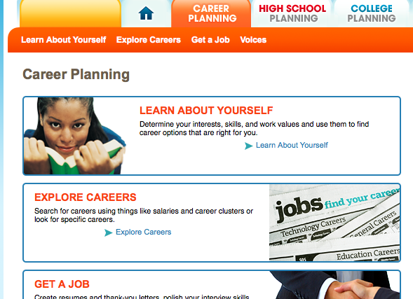
Explore Careers – Take Interest Inventories – Learn about Job Requirements

Slide 10
Consider the following:
Job-Shadowing
Internships
Work-Based Learning
Youth Leadership
CTAE Classes in job areas you think you might like

Slide 11
What you do after high
school depends on your
career choice.
College
Military
Technical School
Special Purpose School

Slide 12
Two-year/Four-year degree or more
Types of Colleges/Universities
University of Georgia (Research)
Georgia Southern University (Regional)
University of North Georgia (Senior)
Young Harris (Two-Year)
Piedmont (Private)
Toccoa Falls (Faith-based)
Notes:
Some careers require two or more years of education beyond high school. Currently the Board of Regents has established levels of colleges and universities. They have also established criteria for admissions to each level. Read the slide quickly. For example: the University of Georgia and Georgia State University are classified as research institutions. A complete list of these schools can be accessed from http://www.usg.edu/ga-easy/campuses/types/.

Slide 13
Careers that Require a 4-year Degree (Bachelor’s Degree)
Medical - Doctor, Nurse,Physical Therapy, Pharmacy
Engineering – Civil, Chemical, Aerospace, Industrial
Computer science – Software Design, Information Systems
Physics and Astronomy
Education - Elementary, Middle School, High School, Post-Secondary
Notes:
Some careers require two or more years of education beyond high school. Currently the Board of Regents has established levels of colleges and universities. They have also established criteria for admissions to each level. Read the slide quickly. For example: the University of Georgia and Georgia State University are classified as research institutions. A complete list of these schools can be accessed from http://www.usg.edu/ga-easy/campuses/types/.

Slide 14
Careers that Require a 4-year Degree (Bachelor’s Degree)
Business – Marketing, Management, Accounting
Architecture and Environmental Design
Public administration
Political science
Government
International Relations
Legal studies - pre-law, lawyer
Notes:
Some careers require two or more years of education beyond high school. Currently the Board of Regents has established levels of colleges and universities. They have also established criteria for admissions to each level. Read the slide quickly. For example: the University of Georgia and Georgia State University are classified as research institutions. A complete list of these schools can be accessed from http://www.usg.edu/ga-easy/campuses/types/.

Slide 15
Admissions to Georgia Public Colleges/Universities
College Preparatory Curriculum (including 2 units of foreign language)
Freshman Index requirements
Minimum SAT/ACT scores
GHSWT (Georgia High School Writing Test)
Notes:
We will focus on four major criteria for admissions: College Preparatory Curriculum, Freshman Index Requirements, Minimum SAT/ACT Scores, and GHSGT.

Slide 16
Freshman Index
FI is based on a student’s SAT/ACT score and high school *core grade point average or HSGPA. (If a student takes more than the required number of units in any one area, the best grades may be used in the calculation).
*Core classes are English, Math, Science, Social Studies and Foreign Language
Notes:
Admissions is also tied to a Freshman Index. Read slide.

Slide 17

Admission usually requires the ASSET or COMPASS
Technical Colleges
Augusta Technical College
West Georgia Technical College
North Georgia Technical College
Griffin Technical College
Lanier Technical College
North Metro Technical College
Ogeechee Technical College
Georgia
Notes:
Some careers require education and training in technical colleges. Enrolling students should prepare to take the ASSET or COMPASS for placement and admissions purposes. Most programs at the technical colleges can be completed in less than two years. Georgia currently has 34 technical colleges, 18 satellite campuses, as well as technical programs at four university system institutions that provide a broad range of career opportunities. These schools offer a variety of associate degree and diploma programs, continuing education programs, and economic/workforce development programs. For more information regarding the programs offered by Georgia’s technical colleges go to www.dtae.org/

Slide 18
Careers that Require a Technical Degree
Airline Industry – Mechanic, Steward/Stewardess, Air Traffic Controller
Sales – Retail, Medical, Construction
Computer - Network, Repair, IT Managers
Public Safety –Fire Fighting, Law Enforcement
Power - Plant Operations, Linemen, Distribution
Medical – Paramedic, X-Ray Tech, Lab, Nursing Assistants, RN, LPN
Notes:
Some careers require two or more years of education beyond high school. Currently the Board of Regents has established levels of colleges and universities. They have also established criteria for admissions to each level. Read the slide quickly. For example: the University of Georgia and Georgia State University are classified as research institutions. A complete list of these schools can be accessed from http://www.usg.edu/ga-easy/campuses/types/.

Slide 19
Careers that Require a Technical Degree
Electrical – Engineer, Repair
Fast Food – Sales
Criminal Justice
Welding
Tool and Die
Mechanic – Diesel, Marine
HVAC – Installation, Repair
Auto – Engine, Auto Body
Notes:
Some careers require two or more years of education beyond high school. Currently the Board of Regents has established levels of colleges and universities. They have also established criteria for admissions to each level. Read the slide quickly. For example: the University of Georgia and Georgia State University are classified as research institutions. A complete list of these schools can be accessed from http://www.usg.edu/ga-easy/campuses/types/.

Slide 20
Check the yellow pages for more information.
Special Purpose Schools
International School of Skin and Nail Care
Southeastern School of Aeronautics
Bauder College
Brown College of Court Reporting and Medical Transcription
Gupton-Jones College of Funeral Services
National Center of Paralegal Training
Executive Travel Institution
Georgia Driving Academy
Notes:
Some careers require special training.

Slide 21
EARN AND LEARN
Programs
Notes:
Some careers combine education and earning.

Slide 22

Military
ASVAB-
Armed
Services
Vocational
Assessment
Battery
A standardized aptitude/career assessment administered by the military that ALL students should consider taking in the 11th grade.
GCIS has a military file that will relate civilian jobs to military life.
http://www.todaysmilitary.com/index.php and
http://asvabprogram.com
Notes:
The military will provide education in a selected field and will pay you! The Georgia Career Information System offers a military file that students and parents can access to gather information about careers and training in the military. Local recruiters can be very helpful with your questions regarding military service or you can access information about military careers at http://www.todaysmilitary.com/index.php The ASVAB, Armed Services Vocational Assessment Battery is administered by the military to students as a career aptitude assessment. The ASVAB measures strengths and weaknesses in eight different areas such as general science. The ASVAB may be the only aptitude assessment students receive while in high school. The ASVAB represents another career assessment that allows students the opportunity to learn about themselves - a critical part of the career planning process.

Slide 23

Apprenticeships
Bricklayers
Carpenters
Cement Masons
Electricians
Heating/Cooling
System Mechanics
Heavy Equipment Operators
Ironworkers
Plumbers/Pipe fitters
Roofers
Welders
GCIS and USDOL offer
information
regarding state
registered
apprenticeships
http://www.doleta.gov/atels_bat/
Notes:
State registered apprenticeships will provide education and will pay you! GCIS offers information including a list of state registered apprenticeship programs in Georgia and the criteria for admission into these program. For more information one can access the Department of Labor website at www.doleta.gov/atels_bat/. Students may also check the local career center for more information.

Slide 24

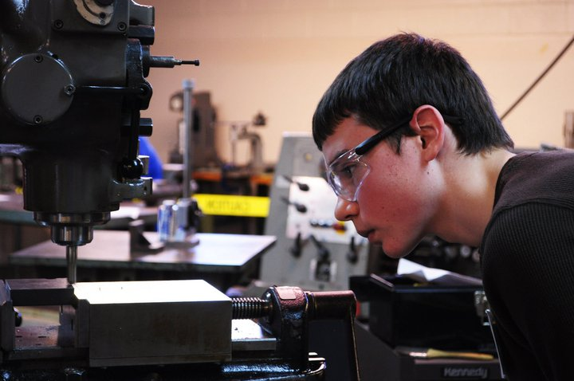
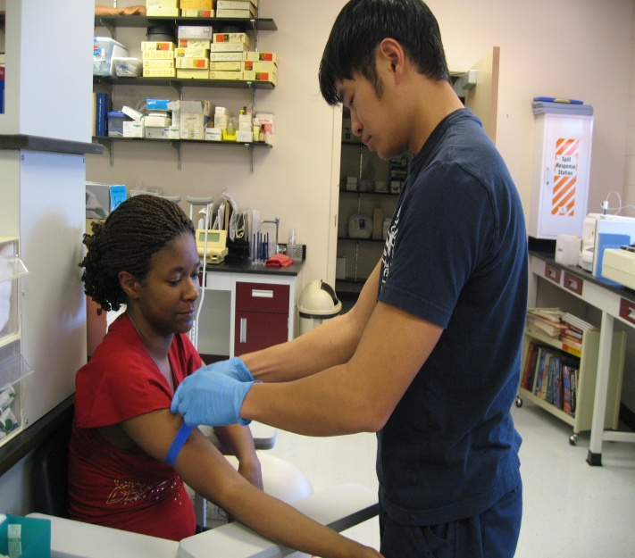

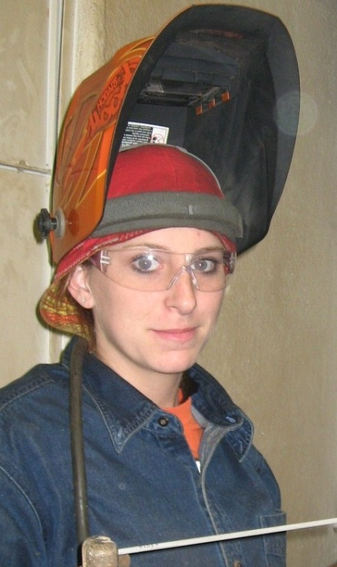

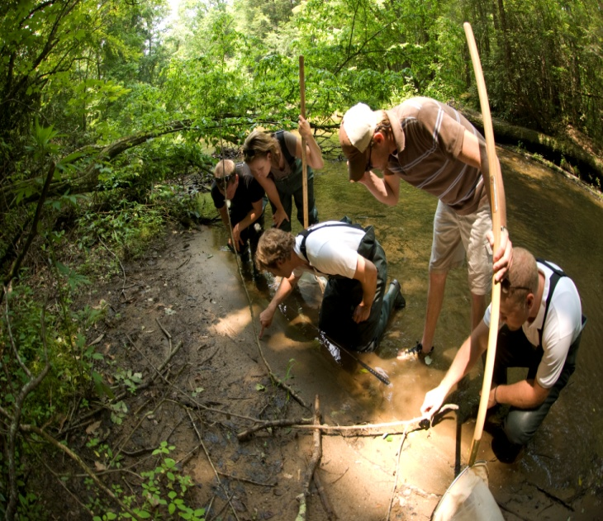
College Credit Now

Slide 25
College Credit Now
  Earn high school credit and college credit at the same time.
Dual Enrollment HOPE Grant
Accel Program
Joint Enrollment (College Credit Only)

Slide 26
Expectations in High School
Develop good study habits
Stay involved in school and community activities
Take challenging courses
Take college prep classes and career oriented classes.
Choose electives wisely
Take PSAT in the 10-11th grades, SAT,
ACT, ASSET, COMPASS
Investigate postsecondary institutions
Continue to investigate financial aid and scholarship opportunities
Don’t slack off!!
Notes:
Read slide.

